Slide 1

HTML Teamwork
University Of Sourcery

Slide 2
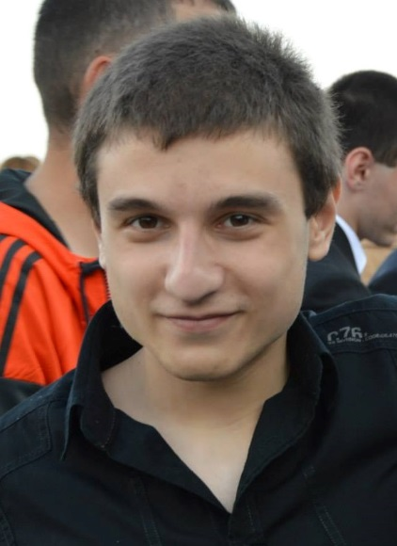
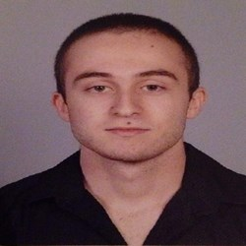
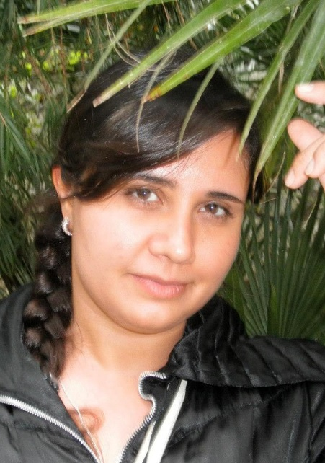
TEAM “SMAUG”
Plamen Hristov
Iliya Stoilov
Plamena Nikolova

Slide 3
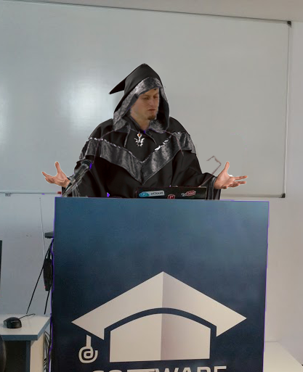
THE FOUNDER
Svetlus Nakovdore

Slide 4
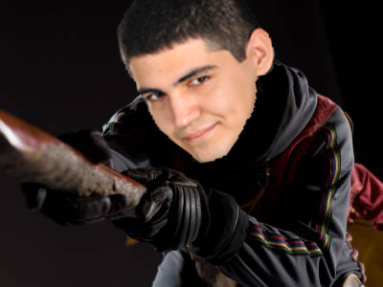
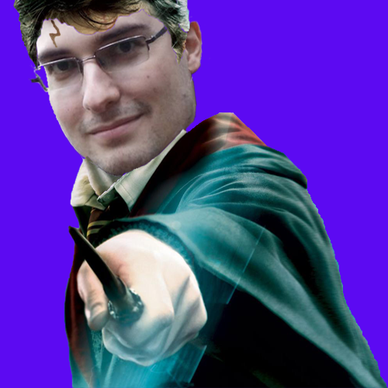
OTHER PROFFESSORS
Vladeus Gagrid
Teodorus Kurtin

Slide 5
LIVE DEMO

